Slide 1


SHOPPING MALL
MANAGEMENT SYSTEM
Presented By
Under the Guidance of
Mrs. KAVYASHREE N
Assistant professor
Department of CSE
Mrs. VIDHYA S G
Assistant professor
Department of ISE
SHARATH J RAO USN:4BW15IS029

Slide 2
CONTENTS
ABSTRACT
INTRODUCTION
SYSTEM REQUIREMENTS
EXISTING SYSTEM
PROPOSED SYSTEM
DESIGN AND ANALYSIS
USE CASE DIAGRAMS
SNAPSHOTS
CONCLUSION
REFERENCES

Slide 3
ABSTRACT
This project is a database based shopping system for an existing mall or shop. The objective of this mini project is to select the products in software which the customers wants to buy. The details of the products are stored in database system.
New products can be inserted through the database without modifying any code. This saves the time of the programmer and we can add new products, modify the existing products and delete the existing products which are not required. The details of products can be edited instantly. The data will be stored in the server. We can create n number of tables, n number of rows and columns. The created data will be stored.

Slide 4
INTRODUCTION
This project is a databased shopping system for an existing mall or shop. The objective of this mini project is to select the products in software which the customers wants to buy. The details of the products are stored in database system.
The database management system is used as backend. For backend we have used XAMPP tool to access the database and servers. The XAMPP provides the servers and sql database. The shops or shopping mall can store their products details with the price and discount and also with the rating of that product. They can access the data of the products easily. The programmer doesn’t need to code every time in programme while adding new products or modifying them. The new products are easily added in database and the added products are displayed with the price, the image of the product, name of the product, discount and ratings.

Slide 5
SYSTEM REQUIREMENTS
HARDWARE REQUIREMENTS
Processor: Pentium 4 2GHz and above
RAM: 2GB RAM
Monitor: 15’’ Colour monitor
Keyboard
Mouse

Slide 6
SYSTEM REQUIREMENTS
SOFTWARE REQUIREMENTS
Operating System: Windows 7 above
User Interface: HTML, CSS.
Programming Language: PHP, Javascript.
Tool: XAMPP
Server: Apache
Database: MySQL

Slide 7
EXISTING SYSTEM
In this existing system the details of the products are added by modifying the code. Here the data cannot be stored and cannot be accessed whenever we need, modifying the code again and again will be the time consuming and data loss will occur. In this system we cannot store the n number of tables of n number of rows and columns. It will be difficult to add the new products or modify the products or delete the products instantly. Here the editing of the products details will be time consuming. The description of the product will be also limited.
Online shopping is the process of buying goods and services from merchants who sell on the Internet and people can purchase just about anything from companies that provide their products online. Online shopping is a form of Electronic Commerce . E-commerce or Electronic commerce.

Slide 8
PROPOSED SYSTEM
In the proposed system we are database management system to store the data and retrieve the data. Here the XAMPP tool is used for server and database. The XAMPP tool provides Apache server, MySql database, Filezilla application, Mercury server, Tomcat. We have used the Apache server and MySql database. The database is used as backend and php, html, javascript are used as front end. Here there is no modifying of code everytime to enter or modify the details of product. This is the time consuming method and easiest method to insert new products or modify the products.
This is the user friendly to use this method. XAMPP is a free and open-source cross-platform web server solution stack package developed by Apache Friends, consisting mainly of the Apache HTTP Server, Maria DB database, and interpreters for scripts written in the PHP and Perl programming languages. Since most actual web server deployments use the same components as XAMPP, it makes transitioning from a local test server to a live server possible.

Slide 9
DESIGN AND ANALYSIS
The most creative and challenging face of the system development is System Design. It provides the understanding and procedural details necessary for the local and physical stages of development. In designing a new system, the system analyst must have a clear understanding of the objectives, which the designing is aiming to fulfill. The first step is to determine how the output is to be produced and in what format. Second, input data and master files have to be designed to meet the requirements of the proposed outputs. The operational phases are handled through program construction and testing.
Design of the system can be defined as a process of applying various techniquesand principles of the process of defining a device, a process, or a system in sufficient detail to permit its physical realization. Thus system design is a solution to “how to” approach to the creation of the new system. This important phase provides the understanding and the procedural details necessary for implementing the system recommended in the feasibility study. The design step provides a data design, and a procedural design.

Slide 10
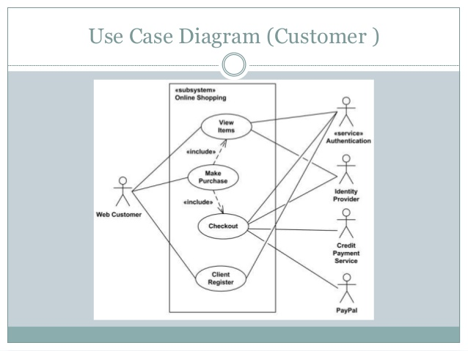
USE CASE DIAGRAM OF CUSTOMER

Slide 11
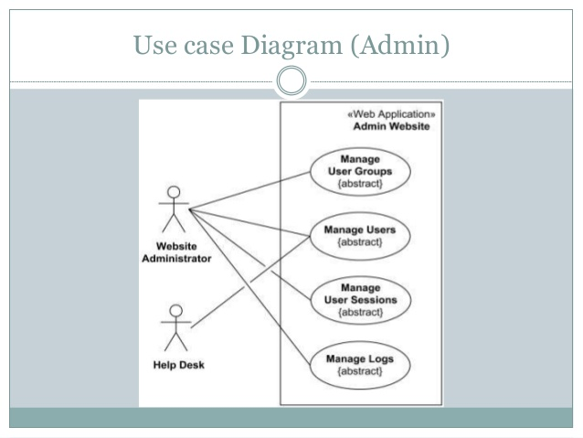
USE CASE DIAGRAM OF ADMIN

Slide 12
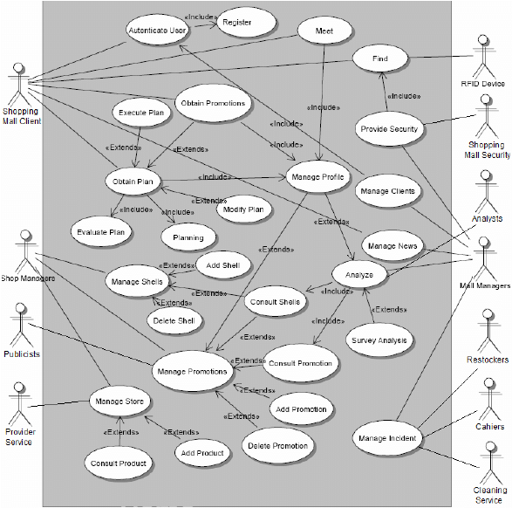
USE CASE DIAGRAM OF SHOPPING MALL

Slide 13
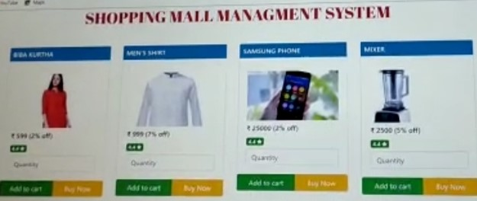
SNAPSHOTS
HOME PAGE

Slide 14
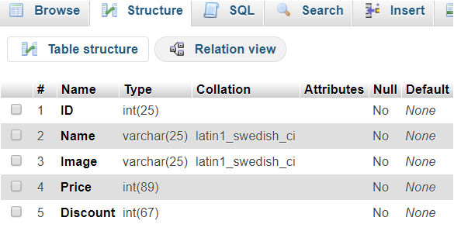
VIEW TABLE STRUCTURE

Slide 15
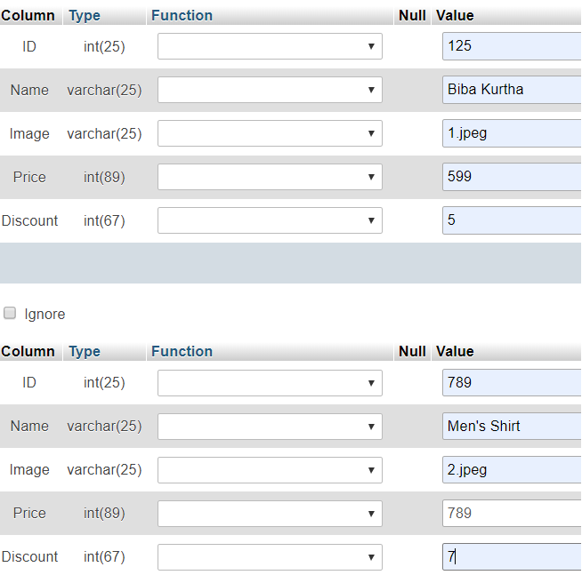
VIEW INSERTION

Slide 16
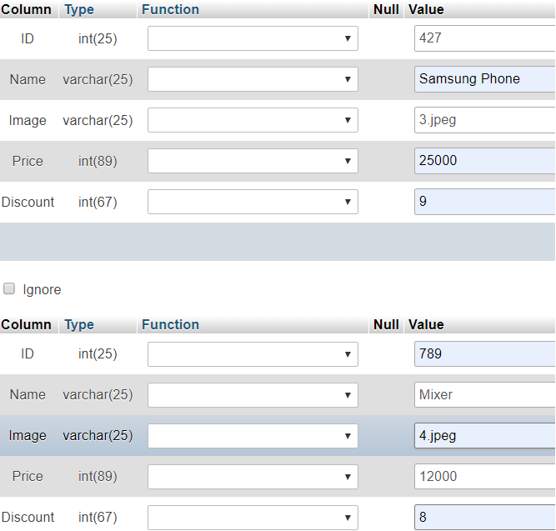
VIEW INSERTION

Slide 17
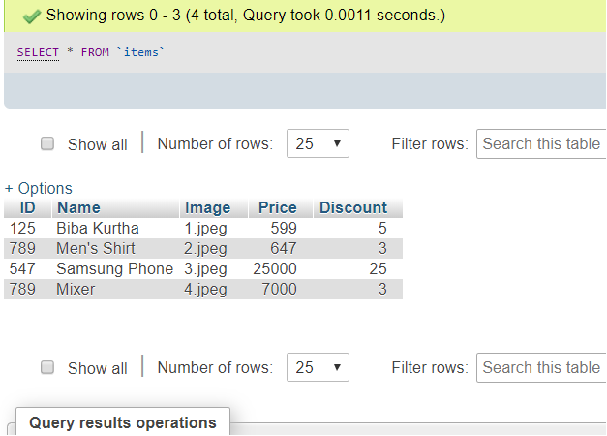
VIEW ITEMS

Slide 18
CONCLUSION
In this project we have used database management system to store the data and retrieve the data. Here the XAMPP tool is used for server and database. The XAMPP tool provides Apache server, MySql database, Filezilla application, Mercury server, Tomcat. We have used the Apache server and MySql database. The database is used as backend and php, html, javascript are used as front end. Here there is no modifying of code everytime to enter or modify the details of product. This is the time consuming method and easiest method to insert new products or modify the products.
This is the user friendly to use this method. XAMPP is a free and open-source cross-platform web server solution stack package developed by Apache Friends, consisting mainly of the Apache HTTP Server, Maria DB database, and interpreters for scripts written in the PHP and Perl programming languages. Since most actual web server deployments use the same components as XAMPP, it makes transitioning from a local test server to a live server possible.

Slide 19
REFERENCES
[1] JavaScript Enlightenment,Cody Lindley-First Edition, based on JavaScript 1.5,
ECMA-262, Edition.
[2] Complete CSS Guide, Maxine Sherrin and John Allsopp-O'Reilly Media; September
2012.
[3] Mc GrawHill’s, Java: The complete reference 7thEdition, Herbert Schildit.
[4] http://www.w3schools.com
[5] https://www.tutorialspoint.com
[6] https://www.ionos.com

